Slide 1
8
Application: The Costs of Taxation

Slide 2

Figure 1 The Effects of a Tax
Price
Supply
Price buyers
Size of tax
pay
Price
without tax
Price sellers
receive
Demand
0
Quantity
Quantity
Quantity
with tax
without tax
Copyright © 2004 South-Western

Slide 3
Figure 2 Tax Revenue
Price
Supply
Price buyers
Size of tax (T)
pay
Tax
revenue
(T × Q)
Price sellers
receive
Quantity
Demand
sold (Q)
0
Quantity
Quantity
Quantity
with tax
without tax
Copyright © 2004 South-Western

Slide 4
Figure 3 How a Tax Effects Welfare
Price
Price
A
Supply
buyers
=
PB
pay
B
Price
C
without tax
=
P1
D
E
Price
sellers
=
PS
receive
F
Demand
0
Q2
Q1
Quantity
Copyright © 2004 South-Western

Slide 5
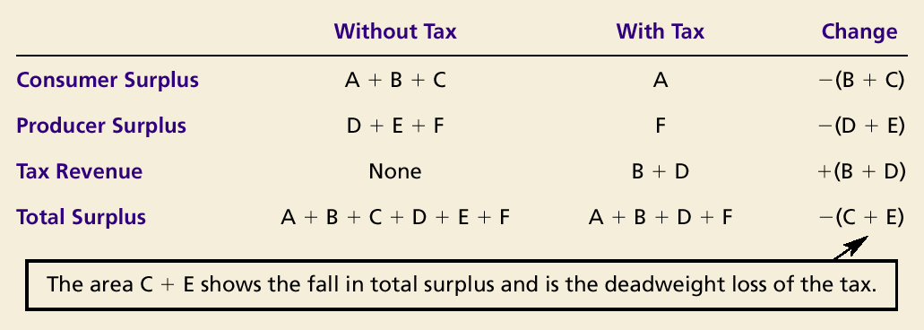
How a Tax Affects Welfare

Slide 6
Figure 4 The Deadweight Loss
Price
Lost gains
Supply
from trade
PB
Size of tax
Price
without tax
PS
Cost to
sellers
Demand
Value to
buyers
0
Q₂
Q₁
Quantity
Reduction in quantity due to the tax
Copyright © 2004 South-Western

Slide 7
Figure 5 Tax Distortions and Elasticities
(a) Inelastic Supply
Price
Supply
When supply is
relatively inelastic,
the deadweight loss
of a tax is small.
Size of tax
Demand
0
Quantity
Copyright © 2004 South-Western

Slide 8
Figure 5 Tax Distortions and Elasticities
(b) Elastic Supply
Price
When supply is relatively
elastic, the deadweight
loss of a tax is large.
Size
Supply
of
tax
Demand
0
Quantity
Copyright © 2004 South-Western

Slide 9
Figure 5 Tax Distortions and Elasticities
(c) Inelastic Demand
Price
Supply
Size of tax
When demand is
relatively inelastic,
the deadweight loss
of a tax is small.
Demand
0
Quantity
Copyright © 2004 South-Western

Slide 10
Figure 5 Tax Distortions and Elasticities
(d) Elastic Demand
Price
Supply
Size
of
tax
Demand
When demand is relatively
elastic, the deadweight
loss of a tax is large.
0
Quantity
Copyright © 2004 South-Western

Slide 11
Figure 6 Deadweight Loss and Tax Revenue from Three Taxes of Different Sizes
(a) Small Tax
Price
Deadweight
loss
Supply
P_{B}
Tax revenue
P_{S}
Demand
0
Q₂
Q₁
Quantity
Copyright © 2004 South-Western

Slide 12
Figure 6 Deadweight Loss and Tax Revenue from Three Taxes of Different Sizes
(b) Medium Tax
Price
Deadweight
P_{B}
loss
Supply
Tax revenue
P_{S}
Demand
0
Q₂
Q₁
Quantity
Copyright © 2004 South-Western

Slide 13
Figure 6 Deadweight Loss and Tax Revenue from Three Taxes of Different Sizes
(c) Large Tax
Price
P_{B}
Deadweight
loss
Supply
Tax revenue
Demand
P_{S}
0
Q₂
Q₁
Quantity
Copyright © 2004 South-Western

Slide 14
Figure 7 How Deadweight Loss and Tax Revenue Vary with the Size of a Tax
(a) Deadweight Loss
Deadweight
Loss
0
Tax Size
Copyright © 2004 South-Western

Slide 15
Figure 7 How Deadweight Loss and Tax Revenue Vary with the Size of a Tax
(b) Revenue (the Laffer curve)
Tax
Revenue
0
Tax Size
Copyright © 2004 South-Western

